Slide 1

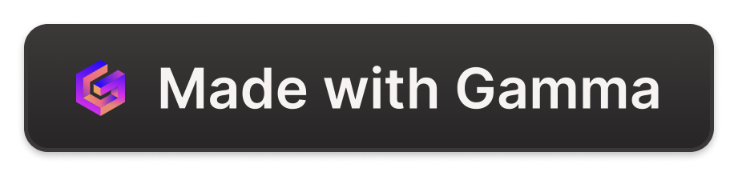
Automatic Speech Recognition (ASR)
Konversi sinyal suara menjadi teks dengan cara mapping sequence dari input suara → output teks. Nantinya aplikasi ini dapat digunakan juga untuk pembuatan teks langsung dari data rekaman audio dan pencatatan selama rapat (notulensi/ Minutes of Meeting).

Slide 2
Latar Belakang
Project ke-3 Bootcamp IndonesiaAI
ASR dikembangkan untuk membantu manusia dalam berinteraksi dengan perangkat secara verbal, meningkatkan aksesibilitas, meningkatkan akurasi, membantu pembelajaran bahasa kedua, meningkatkan pengalaman pelanggan, meningkatkan efektivitas, dan meningkatkan produktivitas dalam berbagai aplikasi

Slide 3

Dataset MInDS-14
MInDS-14 adalah sumber daya training dan evaluasi tugas deteksi intensi dengan data audio dan dapat diaksis di url: https://huggingface.co/datasets/PolyAI/minds14. Paper mengenai info detail data MInDS-14 berjudul Multilingual and Cross-Lingual Intent Detection from Spoken Data. Dataset ini mencakup 14 intensi yang diambil dari sistem komersial di domain e-banking

Slide 4

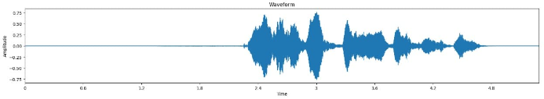
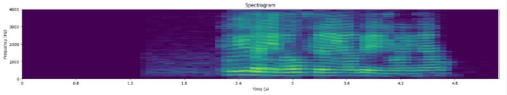
Exploratory Data Analysis (EDA)
Waveform
Spectogram
representasi visual sinyal audio yang menunjukkan bagaimana amplitudo berubah seiring waktu.
representasi visual dari spektrum frekuensi sinyal audio seiring waktu.

Slide 5
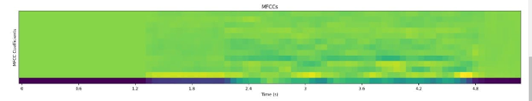
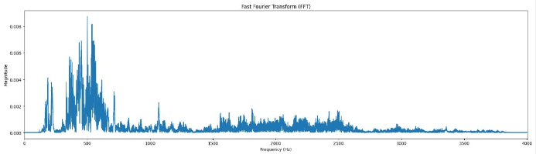
Exploratory Data Analysis (EDA)
MFCC
Mel Frequency Cepstral Coefficients adalah fitur yang digunakan dalam ASR untuk merepresentasikan sinyal audio.
FFT
Fast Fourier Transform merupakan metode yang digunakan untuk mentransformasi sinyal suara menjadi spectrum suara berbasis sinyal frekuensi

Slide 6
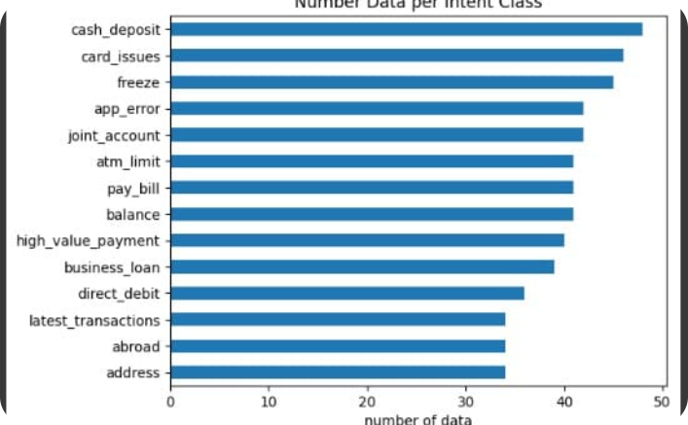
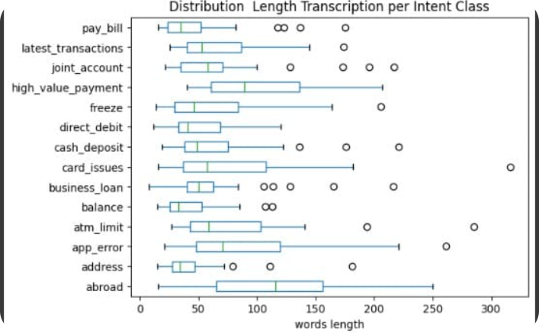
Exploratory Data Analysis (EDA)
Jumlah Data Setiap Kelas
Transkripsi Panjang Distribusi per Kelas Intent

Slide 7
Model Pre-Trained yang Digunakan
Whisper
Whisper menggunakan fitur mel (mel features) sebagai input dan memiliki parameter seperti ukuran kosakata (vocab_size), jumlah fitur mel (num_mel_bins), dan jumlah lapisan encoder (encoder_layers)
1
2
3
wav2vec2
HuBERT (Hidden Unit BERT)
Model Wav2Vec2 dilatih menggunakan metode connectionist temporal classification (CTC) untuk menghasilkan representasi ucapan yang dapat dianalisis
Model Hubert menggunakan arsitektur BERT (Bidirectional Encoder Representations from Transformers)

Slide 8
Perbandingan: Parameter Training
Whisper
Wav2Vec2
HuBERT
training_args = Seq2SeqTrainingArguments( output_dir="./whisper-tiny-minds14", per_device_train_batch_size=32, gradient_accumulation_steps=2, learning_rate=1e-5, lr_scheduler_type="constant_with_warmup", warmup_steps=50, max_steps=1000, gradient_checkpointing=True, fp16=True, fp16_full_eval=True, evaluation_strategy="steps", per_device_eval_batch_size=2, predict_with_generate=True, generation_max_length=225, save_steps=500, eval_steps=500, logging_steps=25, load_best_model_at_end=True, metric_for_best_model="wer", greater_is_better=False, push_to_hub=True, )
training_args = TrainingArguments( output_dir="asr_mind_model", per_device_train_batch_size=4, per_device_eval_batch_size=4, gradient_accumulation_steps=2, learning_rate=1e-4, warmup_steps=500, max_steps=3000, gradient_checkpointing=True, fp16=True, # True only use GPU/ CUDA group_by_length=True, evaluation_strategy="steps", save_steps=500, eval_steps=500, logging_steps=500, load_best_model_at_end=True, metric_for_best_model="wer", greater_is_better=False, # push_to_hub=True, )
training_args = TrainingArguments( output_dir="asr_mind_model", per_device_train_batch_size=1, per_device_eval_batch_size=1, gradient_accumulation_steps=2, learning_rate=1e-4, warmup_steps=500, max_steps=3000, gradient_checkpointing=True, fp16=True, group_by_length=True, evaluation_strategy="steps", save_steps=500, eval_steps=500, logging_steps=500, load_best_model_at_end=True, metric_for_best_model="wer", greater_is_better=False, # push_to_hub=True, )

Slide 9
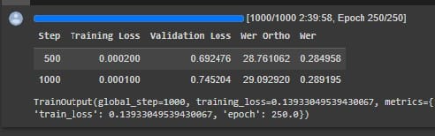
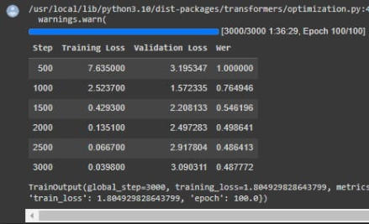
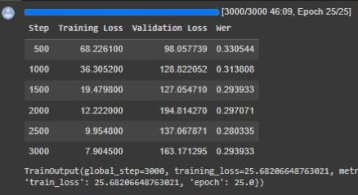
Perbandingan: Output Training
Whisper
HuBERT
Wav2Vec2

Slide 10
Perbandingan: Transcription
Whisper - Sample 1
Wav2Vec2 - Sample 1
HuBERT - Sample 1
transcription referece: HI I'M GOING TO BE GOING ABROAD AND I'D LIKE TO KNOW IF I CAN USE MY CARD IN ENGLAND WHILE I'M THERE AND WORK IF I HAVE TO DO ANYTHING SPECIAL TO ACTIVATE IT transcription prediction: HI I'M GOING TO BE GOING ABROAD AND I'D LIKE TO KNOW IF I CAN USE MY CARD IN ENGLAND WHILE I'M THERE AND WORK IF I HAVE TO DO ANYTHING SPECIAL TO ACTIVATE IT
transcription referece: HI I'M GOING TO BE GOING ABROAD AND I'D LIKE TO KNOW IF I CAN USE MY CARD IN ENGLAND WHILE I'M THERE AND WORK IF I HAVE TO DO ANYTHING SPECIAL TO ACTIVATE IT transcription prediction: HI I'M GOING TO BE GOING ABROAD AND I'D LIKE TO KNOW IF I CAN USE MY CARD IN ENGLAND WHILE I'M THERE AND WORK IF I HAVE TO DO ANYTHING SPECIAL TO ACTIVATE IT
transcription referece: HI I'M GOING TO BE GOING ABROAD AND I'D LIKE TO KNOW IF I CAN USE MY CARD IN ENGLAND WHILE I'M THERE AND WORK IF I HAVE TO DO ANYTHING SPECIAL TO ACTIVATE IT transcription prediction: HI I'M GOING TO BE GOING ABROAD AND I'D LIKE TO KNOW IF I CAN USE MY CARD IN ENGLAND WHILE I'M THERE AND WORK IF I HAVE TO DO ANYTHING SPECIAL TO ACTIVATE IT

Slide 11
Perbandingan: Transcription
Whisper - Sample 4
Wav2Vec2 - Sample 4
HuBERT - Sample 4
transcription referece: HOW DO I SET UP A DIRECT DEBIT
transcription referece: HOW DO I SET UP A DIRECT DEBIT transcription prediction: HOW DO I SET UP A DRECT ADBIT
transcription referece: HOW DO I SET UP A DIRECT DEBIT transcription prediction: HOW DO I SET UP A DIRECT ABBIT
transcription prediction: HOW DO I SET UP A DIRECT APP AT

Slide 12
Perbandingan: Evaluation Metric
WER (Word Error Rate) & CER (Character Error Rate)
Whisper - Sample 1
Wav2Vec2 - Sample 1
HuBERT - Sample 1
WER: 0.0 CER: 0.0
WER: 0.0 CER: 0.0
WER: 0.00 CER: 0.00
Whisper - Sample 4
Wav2Vec2 - Sample 4
HuBERT - Sample 4
WER: 0.25 CER: 0.1
WER: 0.25 CER: 0.17
WER: 0.12 CER: 0.07

Slide 13
Improvement
1
Some transcriptions from the dataset are not accurate, need to review in depth
Remove the background noises
2
Lebih dalam me-review dataset agar kualitas dataset benar-benar bagus. GARBAGE IN, GARBAGE OUT!
Kualitas suara pada dataset sangat mempengaruhi kemampuan yang dipahami oleh model
3
Fine-tune the model on larger data
Membuat model lebih baik lagi dengan data yang lebih banyak

